Slide 1
PC613: Communication Skills
Sem I, MSc IT
Instructor: Dr. Jenson Joseph

Slide 2
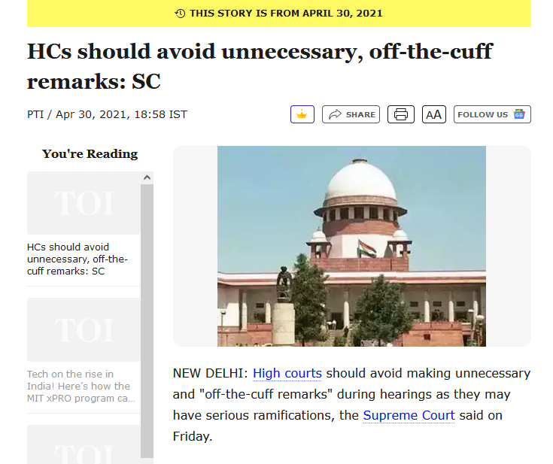
Learn an idiom
“off the cuff”

Slide 3
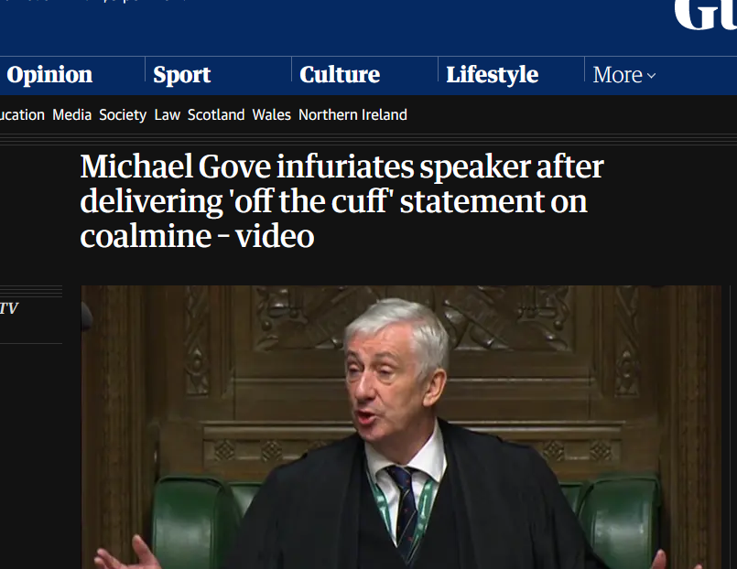
Learn an idiom
“off the cuff”

Slide 4

Learn an idiom
“off the cuff”

Slide 5
Learn an idiom
If you speak off the cuff, you say something without having prepared or thought about your words first:
-- to do something off the cuff means to do it without preparation, or to improvise.
-- spontaneous, informal
Examples:
I hadn't prepared a speech so I just said a few words off the cuff.
I could not answer it off the cuff.
I cannot say, "off the cuff", the exact amount, but it is a substantial matter.

Slide 6
Writing emails
Sub: Request for Review of Group Presentation Script
Respected Sir,
I hope this email finds you well. My name is ----, and I am a student of Msc IT in your communication skills class. I am writing to kindly request your assistance in reviewing the script for an upcoming group presentation.
Our group has been working diligently on this presentation, and we believe that your expertise and guidance would greatly contribute to its refinement.
Would it be possible for you to spare some time to review our script and provide us with your feedback? Your expertise would undoubtedly help us ensure that our presentation is both accurate and compelling.
Thank you very much for considering our request. We look forward to your guidance and insights.
Best regards…

Slide 7
Writing emails
Sub: Submitting Script for Review
Dear Sir,
I hope this email finds you well. My name is ----, from Msc IT, currently attending your Communication Skills class. I am writing this on behalf of our group to request you to (kindly) review the script for our upcoming group presentation. [to submit our script of our group presentation for review…]
I hope you will be able to spare some time to review the script and let us know if there are any corrections.
Thank you and best regards.
Best regards…

Slide 8
From
Jignesh Patil
Data Analyst
Soya Info
To
The CEO
Soya Infotech, Surat

Slide 9
Sub:
Seeking clarification/better compensation/reconsideration of termination
Request to reconsider my termination/Request for better compensation/Regarding your termination letter

Slide 10
\Dear Sir/Madam,
I am Jignesh Patil; I have been working at your company as a Data Analyst since 1 Jan 2023. I am not sure if you are aware of this, but on .... I received a bizarre letter from the HR Department terminating my appointment, citing a mistake that the department committed in the process of recruitment. I am attaching/forwarding the letter for your reference.
I am baffled by the letter. I am extremely surprised and disappointed to get such a letter from you...
I'm truly amazed that such a mistake would happen/occur at such a reputed company...
This puts me in a difficult position/This is not merely unfortunate but also unfair. Having said that, we should think about how to move ahead. The terms in the termination letter do not compensate for the trouble that this has caused me.

Slide 11
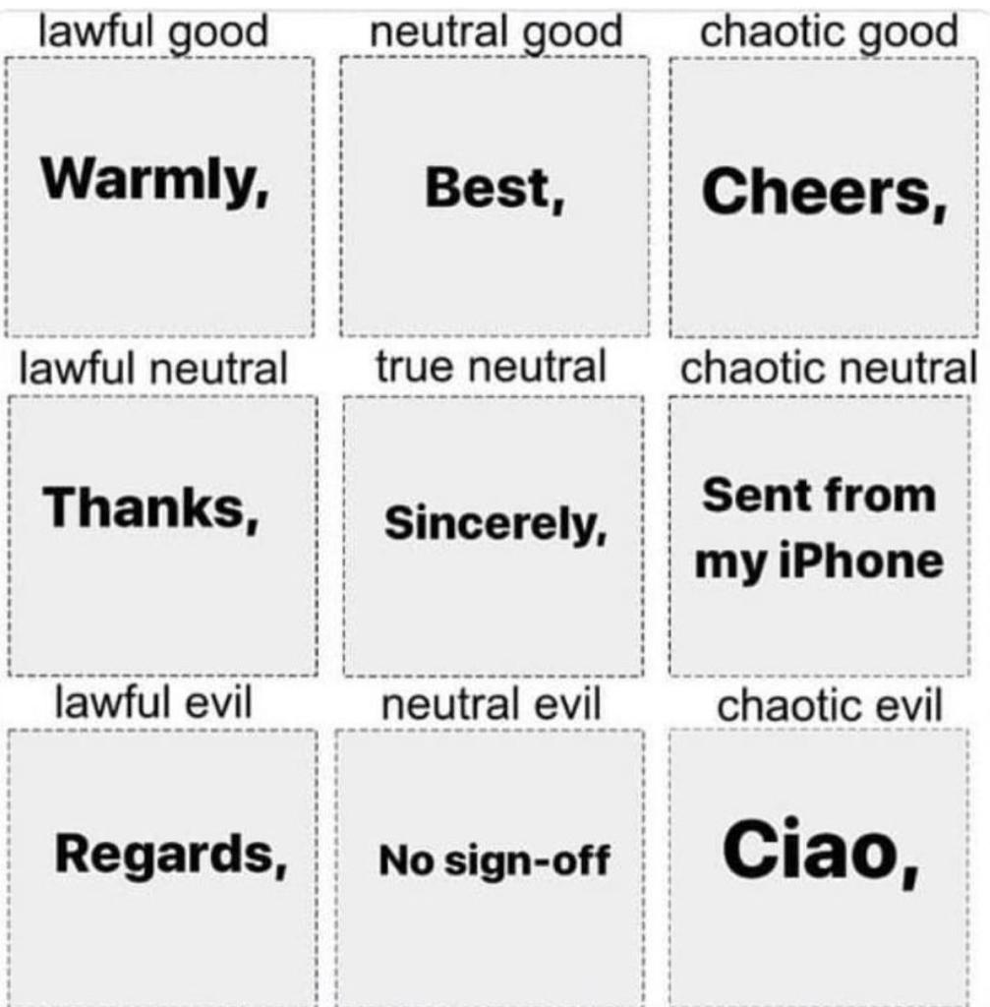
From the world of memes
What email sign-offs mean!

Slide 12
Students yet to do Self Intro
Luhar Karthik,
Bhavish Hiranandani
Rathod Rajdeep Singh
Sosa Siddharth Kumar
Lakshya Jain
Hammad Farid
Jaivik Rajeshbhai
Anjali Singh
Parthiv Zanje
Rupesh Singh
Mehta Khushi
Tarun Kumar

Slide 13
Group Exercise II: Groups of 5 (15 marks)
Exercise: Conceiving, Marketing and Pitching an Entrepreneurial Idea
Tasks:
Collectively brainstorm for a business concept/idea: it can be a start-up; a new firm offering a unique service; a company that makes a unique product, and so on.
Give the company (1) a name or a brand name, and (2) a tagline (like, Amul's "Utterly Butterly Delicious"). The company/brand name and the tagline should be inspired by something local. Like, PhonePe app.
Pitch the idea, the brand name as well as the tag line to a group of potential investors. Explain the process of how you arrived upon the brand name and the tag-line.
Each presentation will involve 2 groups: One group will pitch the idea, and the other group will act as potential investors. For example, when Group 1 pitches the idea, Group 2 will act as the group of investors; and vice versa.

Slide 14
Phrasal verbs: https://www.bbc.co.uk/learningenglish/english/course/intermediate/unit-4/session-2/activity-3
Adverb positions: https://www.bbc.co.uk/learningenglish/english/course/intermediate/unit-15/session-2/activity-3
Modal verbs: https://www.bbc.co.uk/learningenglish/english/course/intermediate/unit-6/session-2/activity-3
How to make a pitch: https://www.youtube.com/watch?v=ZNtPaWmX1EA
On Emails: https://www.themuse.com/advice/how-to-write-professional-email-examples

